Slide 1

Implementation of JNS Algorithm
Group members:
Neil Perira (44) Sneha Varghese (57)
Joel Ulahanna (62)
Guide:
Sankusu Sharma Sir

Slide 2

Introduction
Cryptography
Types of cryptography
1.Symmetric key Cryptography
2.Asymmetric key cryptography

Slide 3
RSA algorithm makes use of two prime numbers to generate the keys for encryption and decryption.
One key is used for encryption and another for decryption
Further enhancement of RSA algorithm is MREA which make use of four prime numbers.

Slide 4

Problem Definition
RSA makes use of two prime numbers whereas MREA uses four prime numbers
MREA also uses additional keys like ʎ,µ,g whose computation requires time
So MREA takes six times more time than that of RSA for encryption and decryption

Slide 5
Scope
The Scope of this project is to decrease the time taken by modified RSA algorithm for encryption and decryption using the following methods:-
1.GNU library
2.Offline Storage

Slide 6
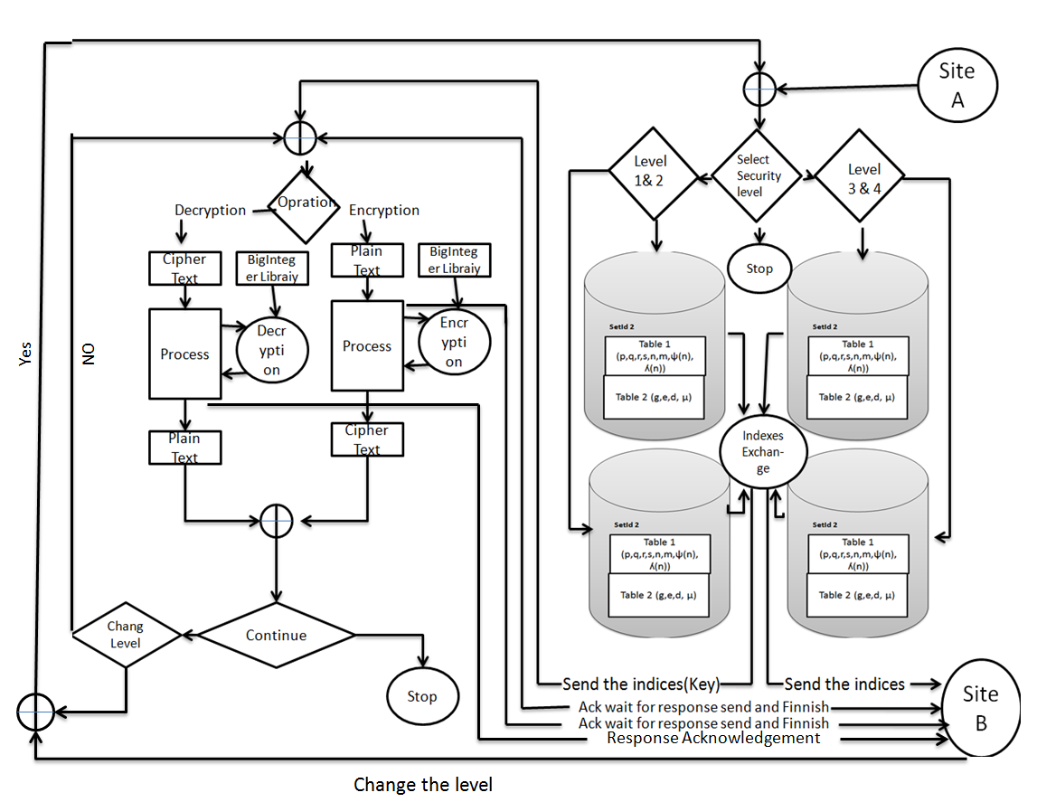
Architecture

Slide 7
UML diagrams

Slide 8
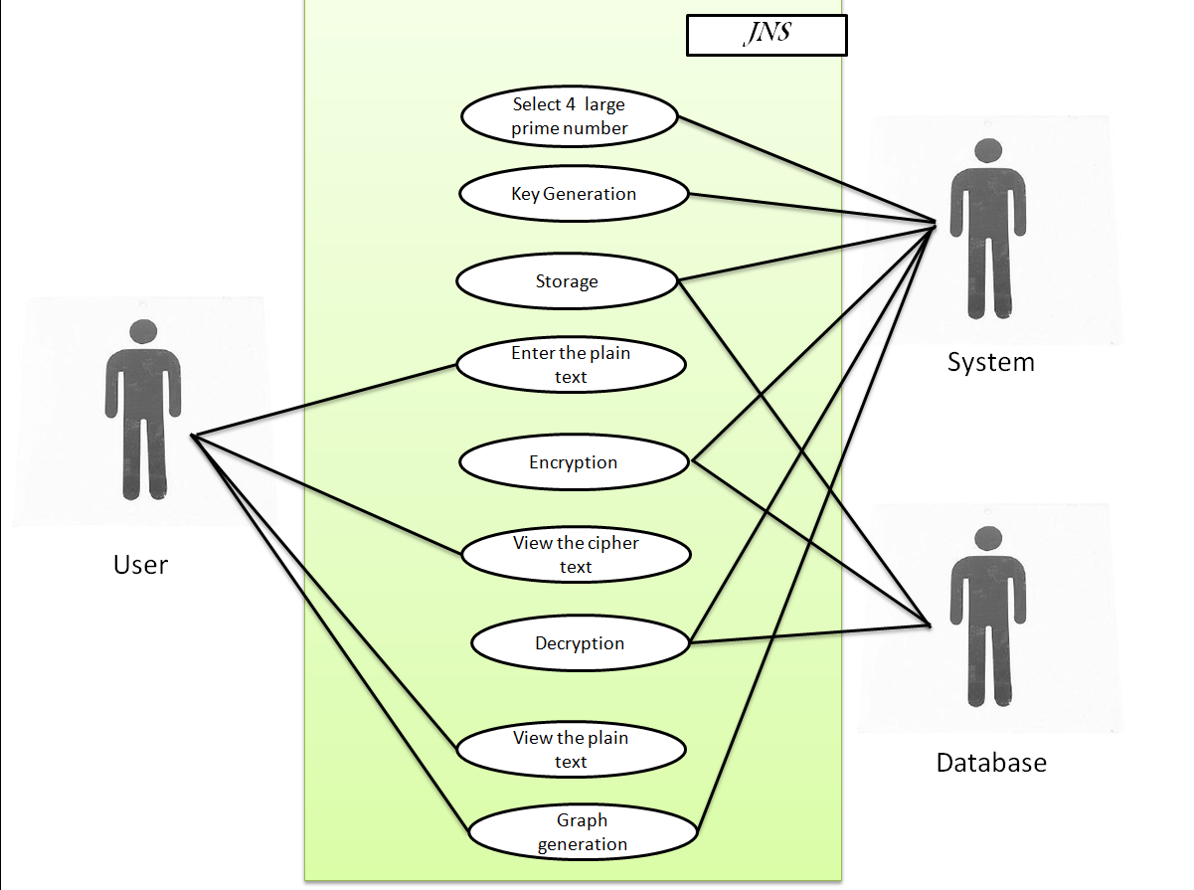
Use case diagram

Slide 9
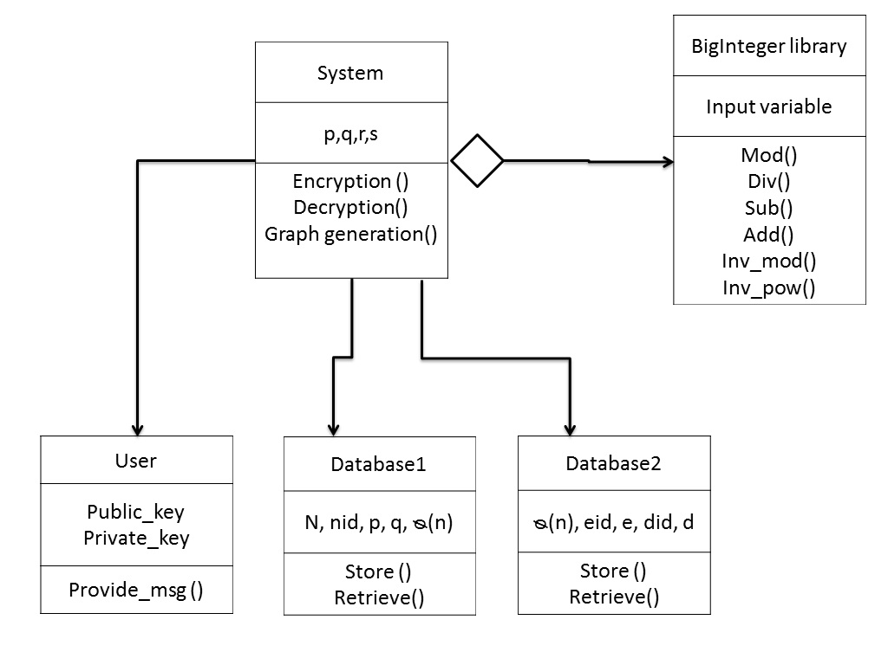
Class diagram

Slide 10
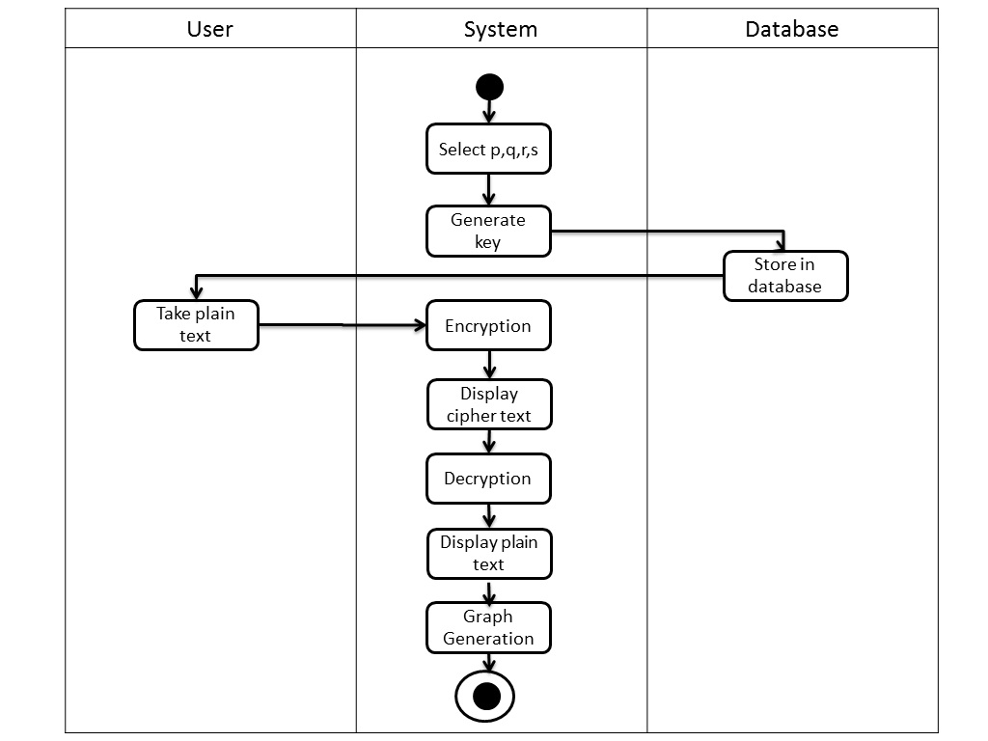
Activity diagram

Slide 11
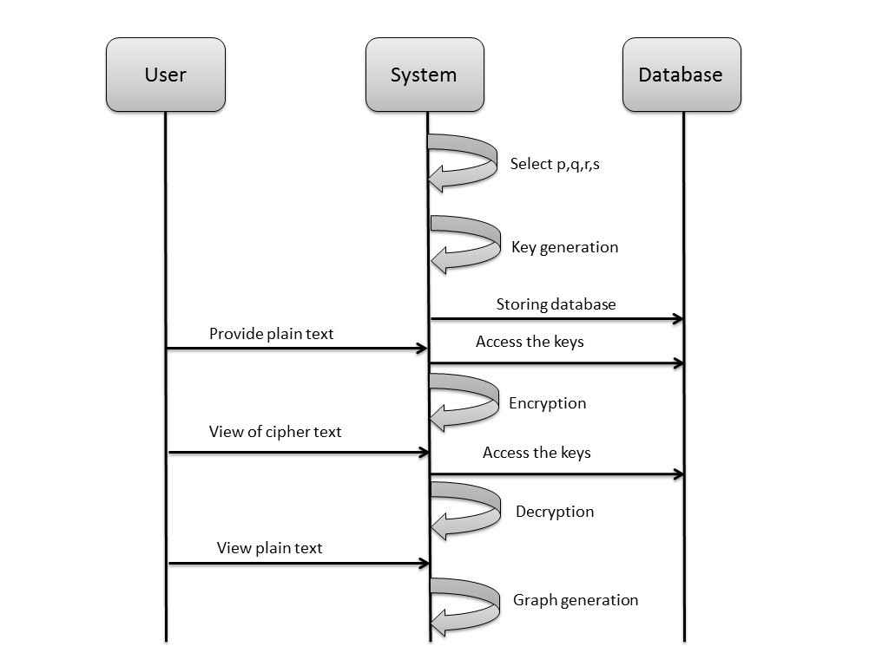
Sequence diagram

Slide 12
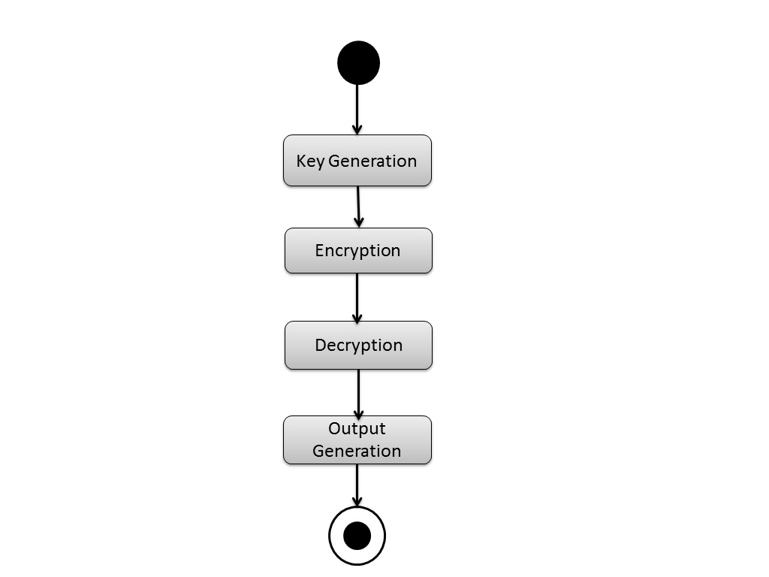
State Transition diagram

Slide 13
Plan of Implementation
Number | Week | Start Date | End date | Activity performed
01. | 1st | 2th Oct 2014 | 14th Oct 2014 | Environmental Setup Finalize and Implementation of GUI
02. | 2nd | 15th Oct 2014 | 21th Oct 2014 | Implementation requirement & knowledge of analysis
03. | 3rd | 1th Jan 2015 | 15st Jan 2015 | Completion of 2nd and 3rd module
04. | 4th | 16th Jan 2015 | 30th Jan 2015 | Completion of 4th and 5th module
05. | 5th | 1st Feb 2015 | 28th Feb 2015 | Testing & Analysis
06. | 6th | 1st Mar 2015 | 15th Mar 2015 | Graph & Result Generation
07. | 7th | 15th Mar 2015 | 30th Mar 2015 | Black Books

Slide 14
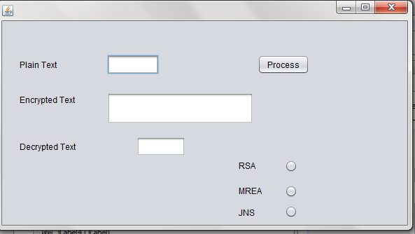
Implementation of one module

Slide 15
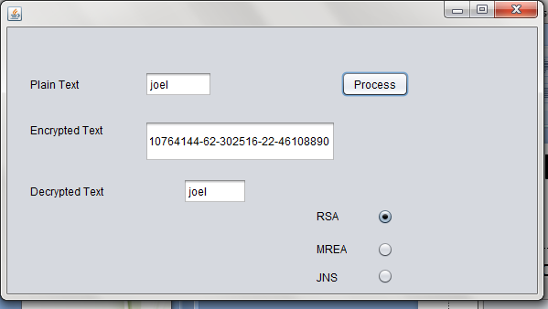
Implementation of one module

Slide 16

Reference
[1] Ravi shankar dhakar, prashant sharma, “modified RSA encryption algorithm (MREA)”, lecturer, GIET, kota, rajasthan, india. Amit kumar gupta asst. Prof. , Sbcet,jaipur, rajasthan, india.
[2] Rajorshi biswas shibdas, “a fast implementation of the rsa algorithm using the gnu mp library”, bandyopadhyay anirban banerjee iiit-calcutta.
[3] MS. Ritu patidar shri vaishnav, “offline storage and prime number “,institute of technology & science, indore, india department of computer science engineering, SVITS, indore, india mrs. Rupali bhartiya
[4] Salah Zaher, amr badr & Ibrahim Farag, “performance enhancement of RSA cryptography algorithm by membrane computing” faculty of computer & information cairo university, egypt tarek abd elmageed governmental security consultant egypt .
[5] Evgeny Milanov, ” The RSA Algorithm” ,3 June 2009.
[6]William Stallings,”Cryptology and Network Security”,An imprint of Pearson Education.

Slide 17


